Slide 1


Music Store
Analysis
"Music is the universal language of mankind."
Start Page
Music Store Analysis

Slide 2


Music
Store Analysis
Objective
To analyze the sales and customer behavior of a digital music store using SQL, helping stakeholders make data-driven decisions regarding product performance, customer preferences, and regional trends.
Next Slide

Slide 3

Music
Store Analysis
Dataset Overview
Dataset Include:
Customer - Name,email,location
Invoice - Date,total,customer ID
InvoiceLine - Track ID,price,quantity
Track - Song name,genre,album
Album - Album name,artist ID
Artist - Artist name
Genre - Genre name
Employee - Sales reps
MediaType - Audio format
.
Next Slide

Slide 4

Music
Store Analysis
Key Analysis area
1.Top-Selling Tracks & Genres
→ Revenue and quantity sold
2. Revenue Trends
→ Monthly/Yearly sales
→ Top genres/artists/media types
3.Customer Behaviour
→ Top spenders, frequency, location
4.Regional Performance
→ High-revenue countries
→ Local genre preferences
5.Sales Rep Performance
→ Customers handled and sales done
Next Slide

Slide 5

Music
Store Analysis
SQL Techniques Used
Joins – INNER, LEFT for combining tables
Aggregate Functions – SUM(), COUNT()
GROUP BY & HAVING – Data grouping and filtering
CTEs & Subqueries – Clean, reusable logic
Window Functions – ROW_NUMBER(), RANK()
Date Functions – MONTH(), YEAR() for trend analysis
Next Slide

Slide 6

Music Store Analysis
SQL Query Examples
Level | Description
Easy | Basic SELECT, WHERE, GROUP BY, ORDER BY
Intermediate | Joins, Aggregations, Filtering with HAVING
Advanced | CTEs, Window Functions, Subqueries
Next Slide

Slide 7
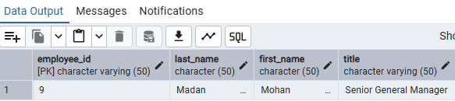
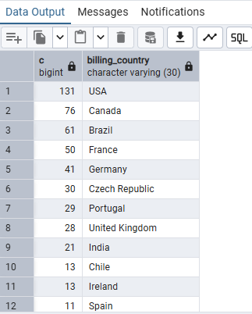
Easy Level Queries with Output
Music Store Analysis
--1. Who is the senior most employee based on job title?
select * from employee
order by levels desc
limit 1
--2. Which countries have the most Invoices?
select count(*) as c,billing_country
from invoice
group by billing_country
order by c desc;
Next Slide

Slide 8
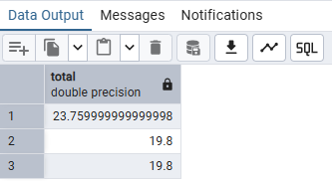
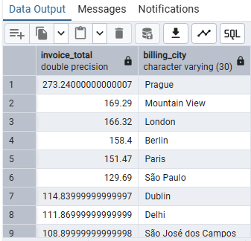
--3. What are top 3 values of total invoice?
select total from invoice
order by total desc
limit 3;
--4. Which city has the best customers? We would like to throw a promotional Music
Festival in the city we made the most money. Write a query that returns one city that
has the highest sum of invoice totals. Return both the city name & sum of all invoice
totals
select sum(total)
as invoice_total,billing_city
from invoice
group by billing_city
order by invoice_total desc;
Music Store Analysis
Next Slide

Slide 9
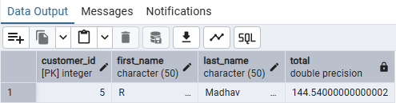
5. Who is the best customer? The customer who has spent the most money will be
declared the best customer. Write a query that returns the person who has spent the
most money
select customer.customer_id,customer.first_name,customer.last_name,sum(invoice.total)
as total
from customer
join invoice on customer.customer_id=invoice.customer_id
group by customer.customer_id
order by total desc
limit 1
Music Store Analysis
Next Slide

Slide 10
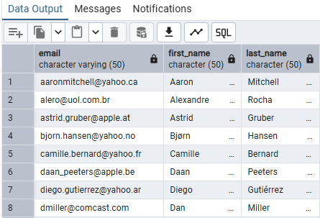
Intermediate Level Queries with Output
Music Store Analysis
--1. Write query to return the email, first name, last name, & Genre of all Rock Music
--listeners. Return your list ordered alphabetically by email starting with A
select distinct email,first_name,last_name
from customer
join invoice on customer.customer_id=invoice.customer_id
join invoice_line on invoice.invoice_id=invoice_line.invoice_id
where track_id in(
select track_id from track
join genre on track.genre_id=genre.genre_id
where genre.name like 'Rock'
)
order by email;
Next Slide

Slide 11
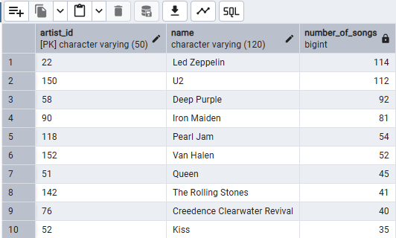
--2. Let's invite the artists who have written the most rock music in our dataset. Write a
--query that returns the Artist name and total track count of the top 10 rock bands
select artist.artist_id, artist.name,count(artist.artist_id) as number_of_songs
from track
join album on album.album_id=track.album_id
join artist on artist.artist_id=album.artist_id
join genre on genre.genre_id=track.genre_id
where genre.name like 'Rock'
group by artist.artist_id
order by number_of_songs desc
limit 10;
Music Store Analysis
Next Slide

Slide 12
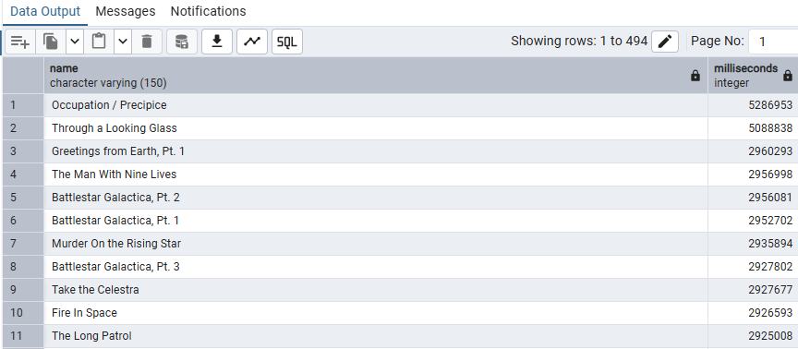
--3. Return all the track names that have a song length longer than the average song length.
--Return the Name and Milliseconds for each track. Order by the song length with the
--longest songs listed first
select name,milliseconds
from track
where milliseconds>(
select avg(milliseconds)as avg_track_length
from track)
order by milliseconds desc;
select name,milliseconds
from track
where milliseconds>393599
order by milliseconds desc;
Music Store Analysis
Next Slide

Slide 13
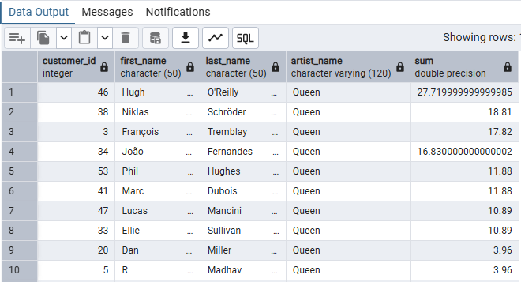
Advance Level Queries with Output
Music Store Analysis
--1. Find how much amount spent by each customer on artists? Write a query to return
--customer name, artist name and total spent
with best_selling_artist as(
select artist.artist_id as artist_id,artist.name as artist_name,
sum(invoice_line.unit_price * invoice_line.quantity)as total_sales
from invoice_line
join track on track.track_id=invoice_line.track_id
join album on album.album_id=track.album_id
join artist on artist.artist_id=album.artist_id
group by 1
order by 3 desc
limit 1
)
select c.customer_id,c.first_name,c.last_name,bsa.artist_name,
sum(li.unit_price)
from invoice i
join customer c on c.customer_id=i.customer_id
join invoice_line li on li.invoice_id=i.invoice_id
join track t on t.track_id=li.track_id
join album alb on alb.album_id=t.album_id
join best_selling_artist bsa on bsa.artist_id=alb.artist_id
group by 1,2,3,4
order by 5 desc;
Next Slide

Slide 14
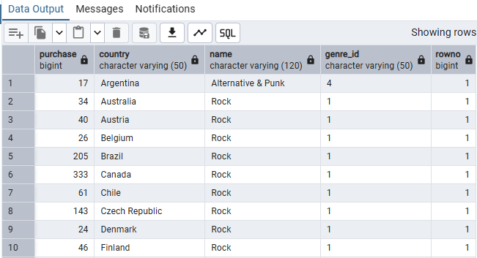
--2. We want to find out the most popular music Genre for each country. We determine the most popular genre as the genre with the highest amount of purchases. Write a query
--that returns each country along with the top Genre. For countries where the maximum
--number of purchases is shared return all Genres
with popular_genre as
(
select count(invoice_line.quantity)as purchase,customer.country,genre.name,genre.genre_id,
row_number() over(partition by customer.country order by count(invoice_line.quantity)desc) as rowno
from invoice_line
join invoice on invoice.invoice_id=invoice_line.invoice_id
join customer on customer.customer_id=invoice.customer_id
join track on track.track_id=invoice_line.track_id
join genre on genre.genre_id=track.genre_id
group by 2,3,4
order by 2 asc, 1 desc
)
select * from popular_genre where rowno <= 1
Music Store Analysis
Next Slide

Slide 15
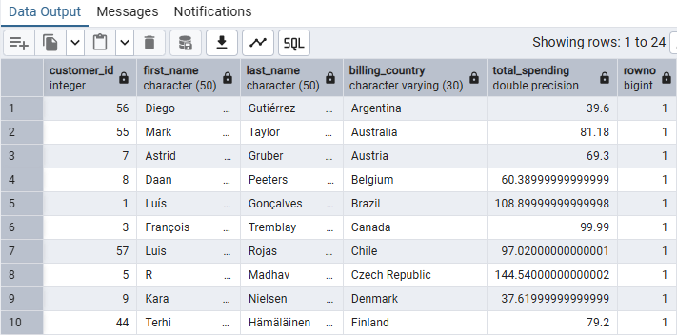
--3. Write a query that determines the customer that has spent the most on music for each country. Write a query that returns the country along with the top customer and how much they spent. For countries where the top amount spent is shared, provide all customers who spent this amount
WITH customer_with_country AS (
SELECT
customer.customer_id,
first_name,
last_name,
billing_country,
SUM(total) AS total_spending,
ROW_NUMBER() OVER
(PARTITION BY billing_country ORDER BY SUM(total) DESC)
AS rowno
FROM invoice
JOIN customer ON customer.customer_id = invoice.customer_id
GROUP BY customer.customer_id, first_name, last_name, billing_country
)
SELECT *
FROM customer_with_country
WHERE rowno <= 1;
Music Store Analysis
Next Slide

Slide 16
Music Store Analysis
Business Insights Gained
✅ Identify best-selling genres and artists
✅ Recognize high-value customers
✅ Improve marketing by region and taste
✅ Boost revenue via focused sales strategies
✅ Measure and reward employee performance
Next Slide

Slide 17
Music Store Analysis
Tools & Technologies
SQL (PostgreSQL/MySQL
Excel
Next Slide

Slide 18
Music Store Analysis
Tools & Technologies
SQL (PostgreSQL/MySQL
Excel
Next Slide

Slide 19
Music Store Analysis
Conclusion
Final Thoughts:
SQL-powered analysis provides deep insight into music sales, helping optimize marketing, boost sales,
and understand customers better.
Next Slide

Slide 20
Icons

Slide 21
Icons

Slide 22
How To Edit Shapes
You can add and edit some shapes to your presentation to present your data in a visual way.
Choose your favourite infographic and insert it in your presentation using Ctrl C + Ctrl V or Cmd C + Cmd V in Mac.
Select one of the parts and ungroup it by right-clicking and choosing “Ungroup”.
Change the color by clicking on the paint bucket.
Then resize the element by clicking and dragging one of the square-shaped points of its bounding box (the cursor should look like a double-headed arrow). Remember to hold Shift while dragging to keep the proportions.
Group the elements again by selecting them, right-clicking and choosing “Group”.
Repeat the steps above with the other parts and when you’re done editing, copy the end result and paste it into your presentation.
Remember to choose the “Keep source formatting” option so that it keeps the design. For more info, please visit Slideegg (Tips & Tricks).

Slide 23
Terms Of Use (Free Users)
If you are a free subscriber, you should credit SlideEgg by keeping the “Thank You” slide.
Kindly refer to the following slide for the Terms of Use for premium users.
You can:
Customize or edit this template
Use this template for both business and personal endeavors.
You can not:
Sell, rent, or second-license SlideEgg content or its altered version. Promulgate, unless explicitly permitted, SlideEgg content, by SlideEgg.
Incorporate SlideEgg content in any database or file online or offline.
Obtain SlideEgg content’s copyright.
Kindly refer to our Tutorial page or FAQ for advanced slide modification guidelines.

Slide 24
Terms Of Use (Premium Users)
Being a premium subscriber, you have the privilege of using this PPT template
without giving attribution to SlideEgg or keeping the “Thank You” slide.
You can:
Customize or edit this template.
Use this template for both business and personal endeavors.
Circulate or share the editable format of this template with anyone you want.
You can not:
Sell, rent or second-license SlideEgg content or the altered version of it. Promulgate or include the templates in any other services database
that performs as distribution or resale platform, unless explicitly permitted, by SlideEgg.
Incorporate the elements used in SlideEgg’s templates separately.
Obtain SlideEgg’s copyright for the elements used in this template as a logo or trademark.
Kindly refer to our Tutorial page or FAQ for advanced slide modification guidelines.

Slide 25





Thank You!
We respect your valuable time with SlideEgg!
If you have any questions, please reach us
Do you have a design request, please visit our redesign page.
CREDIT: SlideEgg created this PowerPoint template.
Let this slide be kept for attribution.
www.slideegg.com

